Slide 1
Wireless sensor network
based on nRF51822
Michał Budzoń

Slide 2
Assumptions
sensor network
Wireless
Creating the network consisted of many sensors ( remotely controlled devices )
Integration a few standards wihin the whole system (2.4GHz, 433MHz, BLE, etc.)
Simplicity to add new sensors
Rather rare measurements updating (from a few seconds to hours)
System supervision via TCPIP set of protocols

Slide 3
Requirements
sensor network
Wireless
Essentials
Energy saving
Simplicity
Trade-offs
Low transfer rates (not a problem)
Reliability
Small responsiveness (not a problem)
Flexibility

Slide 4
Architecture
sensor network
Wireless
Sensor
Other peripherial integrator
Heater
Peripherial integrator
Central data integrator
Some device
Relay
Supervisor

Slide 5
Architecture
sensor network
Wireless
Sensor
Other peripherial integrator
Heater
Peripherial integrator
Central data integrator
Some device
Relay
Supervisor

Slide 6

Architecture
sensor network
Wireless
Sensor
Other peripherial integrator
Heater
Central data integrator
Some device
PCA10000
Relay
Supervisor

Slide 7
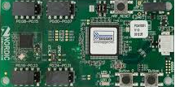
Architecture
sensor network
Wireless
PCA10001
Other peripherial integrator
PCA10001
Central data integrator
Some device
PCA10000
PCA10001
Supervisor

Slide 8
Architecture
sensor network
Wireless
PCA10001
Other peripherial integrator
BLE 4.0
PCA10001
BLE 4.0
Central data integrator
Some device
PCA10000
BLE 4.0
PCA10001
Supervisor

Slide 9

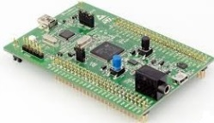
Architecture
sensor network
Wireless
PCA10001
Other peripherial integrator
BLE 4.0
PCA10001
BLE 4.0
Some device
PCA10000
BLE 4.0
PCA10001
Supervisor

Slide 10
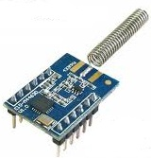
Architecture
sensor network
Wireless
PCA10001
BLE 4.0
PCA10001
BLE 4.0
Some device
PCA10000
BLE 4.0
PCA10001
Supervisor

Slide 11
Architecture
sensor network
Wireless
PCA10001
BLE 4.0
MODBUS
PCA10001
BLE 4.0
MODBUS
MODBUS
or other
Some device
PCA10000
BLE 4.0
PCA10001
Supervisor

Slide 12
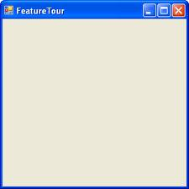
Architecture
sensor network
Wireless
PCA10001
BLE 4.0
MODBUS
PCA10001
BLE 4.0
MODBUS
MODBUS
or other
Some device
PCA10000
BLE 4.0
TCPIP
PCA10001

Slide 13

Architecture
sensor network
Wireless
PCA10001
BLE 4.0
MODBUS
PCA10001
BLE 4.0
MODBUS
MODBUS
or other
PCA10000
BLE 4.0
TCPIP
PCA10001

Slide 14
Device type
Three examplary types are already implemented:
temperature sender
DATA INTEGRATOR WITH MODBUS
led driver
S110
S110
S120

Slide 15
Device type
Temperature sensor features:
Temperature measurements and battery level are send in advertising packet, to be precise – in service data
Values are updated every fixed time due to app_timer’s timeout
Compatible with nRF Temp 2.0 Androis/iOS app
Non-connectable, only one-way communication is possible
temperature sensor

Slide 16
Device type
Three examplary types are already implemented:
temperature sender
DATA INTEGRATOR WITH MODBUS
led driver

Slide 17
Device type
Led driver features:
Sends led’s color and advertising interval in advertising packets, to be precise – in service data
Both above values can be manually modified
Two-way communication
Fast connect->write->disconnect sequence
led driver

Slide 18
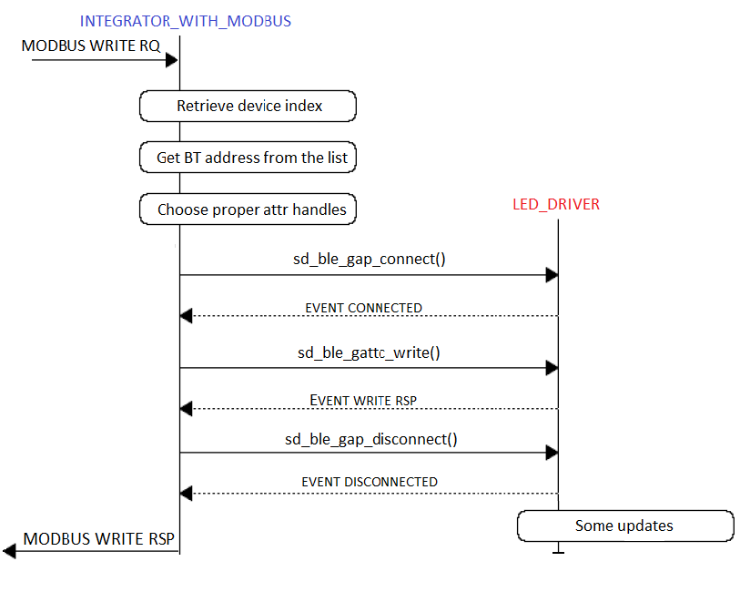
Device type
Writing to led driver time diagram:

Slide 19
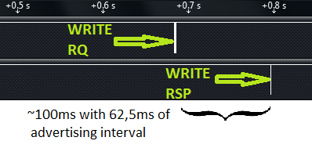
Device type
Writing to led driver from MODBUS point of view:
Screen comes from Salea Logic Analyzer:
TX
RX

Slide 20
Device type
Three examplary types are already implemented:
temperature sender
DATA INTEGRATOR WITH MODBUS
led driver
S110
S110
S120

Slide 21
Device type
Data integrator features:
Handles three basic MODBUS requests: read, write and get device information
Collects data from sensors by advertising packets and parsing service data field
Stores all compatible devices on the list
If requested, writes to characteristic by fast sequence connect->write->disconnect
DATA INTEGRATOR WITH MODBUS

Slide 22
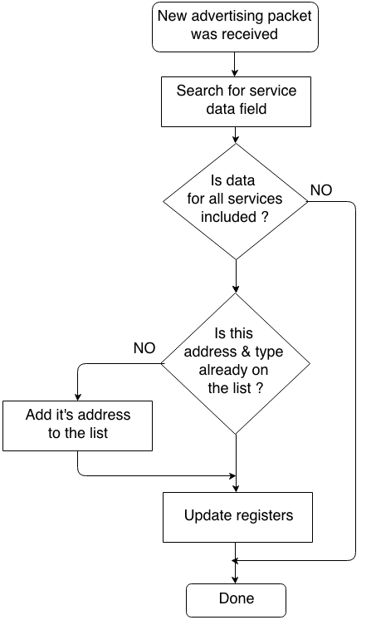
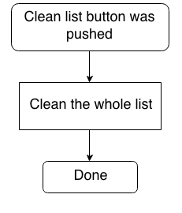
Data integrator
Adding a new device to the list:
Removing devices from the list:

Slide 23
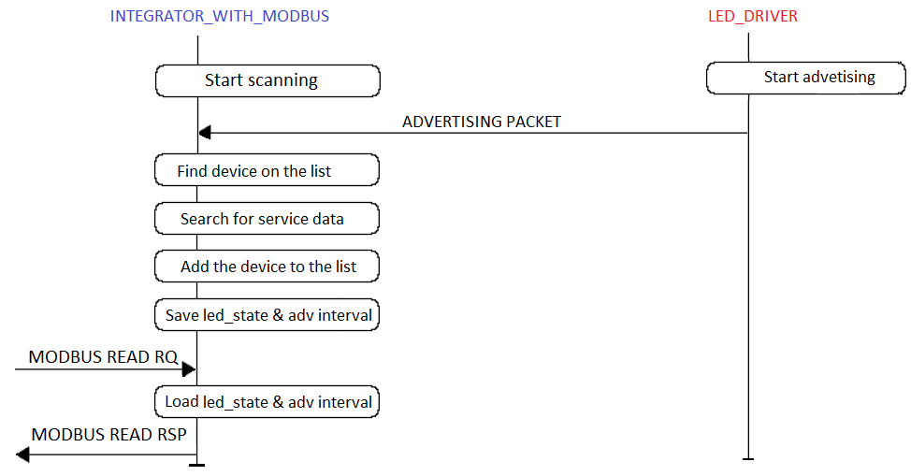
Data integrator
Receiveing the packet first time - diagram:

Slide 24
Data integrator
MODBUS registers organization:
0x00
Sensors number
0x01-0x08
Sensor 0
Sensor type (R)
data byte1
data byte2.
.
data byte7
0x09 – 0x10
Sensor 1
Sensor type (R)
data byte1
data byte2.
.
data byte7
0x11 – 0x18
Sensor 2
Sensor type (R)
data byte1
data byte2.
.
data byte7
sensor type (R)
data byte 1
data byte 2
data byte 3
data byte 4
data byte 5
data byte 6
data byte 7
0xy – 0xz
Sensor X
Sensor type (R)
data byte1
data byte2.
.
data byte7

Slide 25
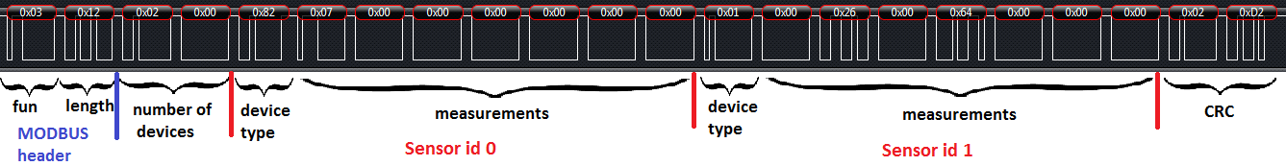
Data integrator
MODBUS response for read request:
Examplary data integrator’s response for request to return 18B from memory registers starting at 0x00.

Slide 26
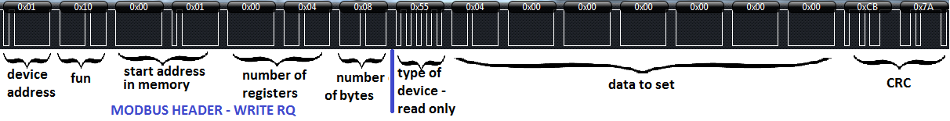
Data integrator
Write request handling:
a
1. WRITE RQ
Data
integrator
MODBUS registers
5. Memory is updated, changed
value is visible
throug MODBUS read rq
2.CONNECT->WRITE->DISCONNECT
4. Update advertising packet and send it.
led
driver
3. Change color

